Slide 1





Shield Insurance Business Analysis
Shield Insurance is a leading provider of comprehensive insurance solutions, serving businesses and individuals of all Age Groups with tailored coverage and exceptional customer service.
by Vineet Patyal

Slide 2

Contents
About Shield Insurance Company
1
2
Objective
Shield Insurance aims to leverage data analysis to gain valuable insights into their customer base, revenue generation, and business performance.
Data set, Data Model & Dashboard
3
Used Power BI Intelligence tool to analyse the given data set , data modelling and creation of Dashboards.
4
Key Insights
These objectives involves gathering critical insights to inform strategic decisions and business growth for Shield Insurance.

Slide 3
About Shield Insurance
Shield insurance is fictional insurance company. This company was founded with a vision to become a trusted partner for our clients, providing innovative insurance solutions that protect their assets and ensure their financial security.
Shield insurance has sales offices in major cities such as Delhi NCR, Indore, Chennai, Mumbai and Hyderabad. A diverse set of policies, catering to customers demand via online platforms such as website and application, as well as offline channel agents and direct services.

Slide 4
Objective
1
Analyze Customer Base
and Revenue Generation
2
Policy Changes Monitoring
Identifying the total number of customers and tracking total revenue generated.
Monitoring customer growth rate and revenue growth rate on a daily basis.
Analysing changes in policies on a month-over-month basis to identify trends and areas for improvement.
3
Trend Analysis Over Time
4
Sales Mode and Age Groups Analysis
Developing visualizations to analyse trends in customer and revenue growth over time.
Analysing customer demographics by sales mode to understand customer preferences and behaviours.
Assessing the impact of age groups on expected settlements, sales mode preferences, and policy choices.

Slide 5
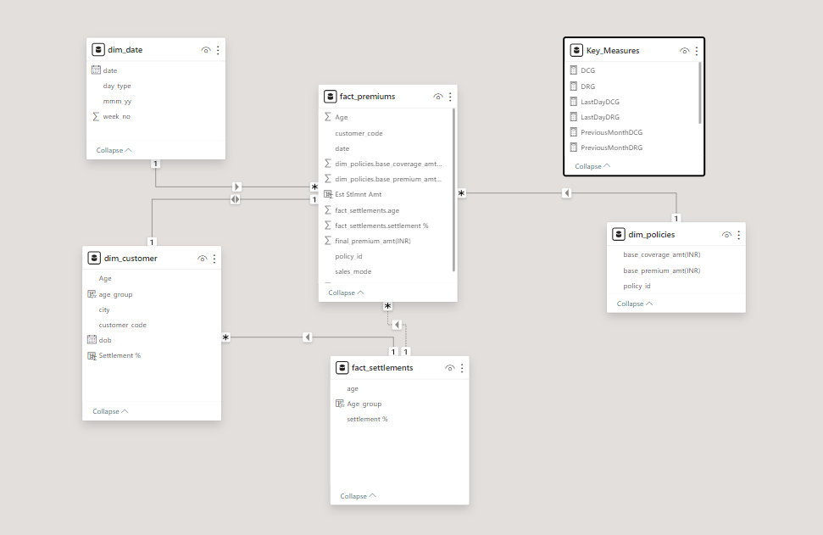
Dataset and Data Modeling
Brief on Dataset
Data is available in csv format from November 2022 to April 2023.
There are two fact tables and four-dimension tables.
There were some common columns in each table which were used to create a data model.

Slide 6


Dashboard Interaction
Microsoft Power Bi

Slide 7
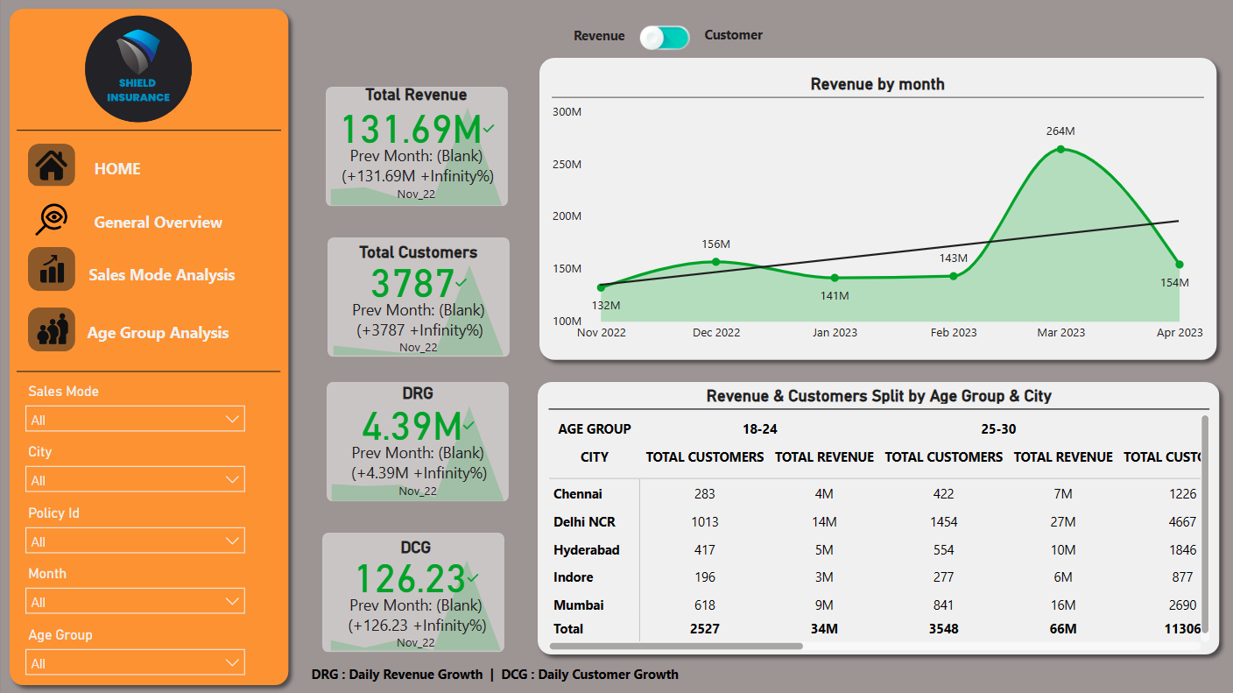
General Overview
Insights
March 23 was the highest Revenue Generating and highest customer acquisition month.
People in age group of 31-40 were the highest contributor for March month in both revenue generation & customer onboarding.
As march is a financial year closing month , so Tax harvesting & Tax saving is a major factor of sudden rise in revenue & customer acquisition.
Overall in 6 months Delhi NCR led in revenue and customer acquisition with total revenue inr 4.86 M and 1643 customers.

Slide 8
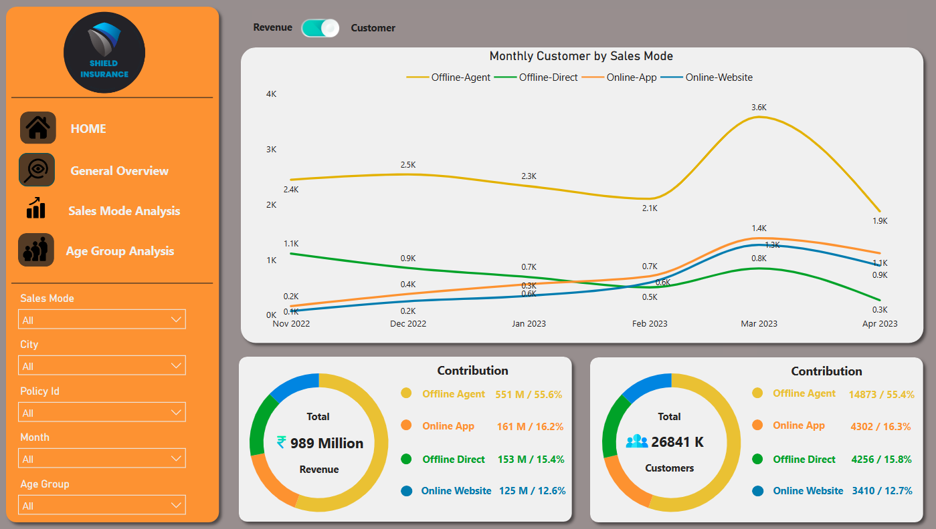
Sales Mode Analysis
Insights
Offline Agent contributes the most around 55% in both revenue generation and customer acquisition.
Business on online platform has seen a rise from Feb 2023.
Overall trend of online website & Online application is in uptrend.
Offline direct and offline agent is in down trend.

Slide 9
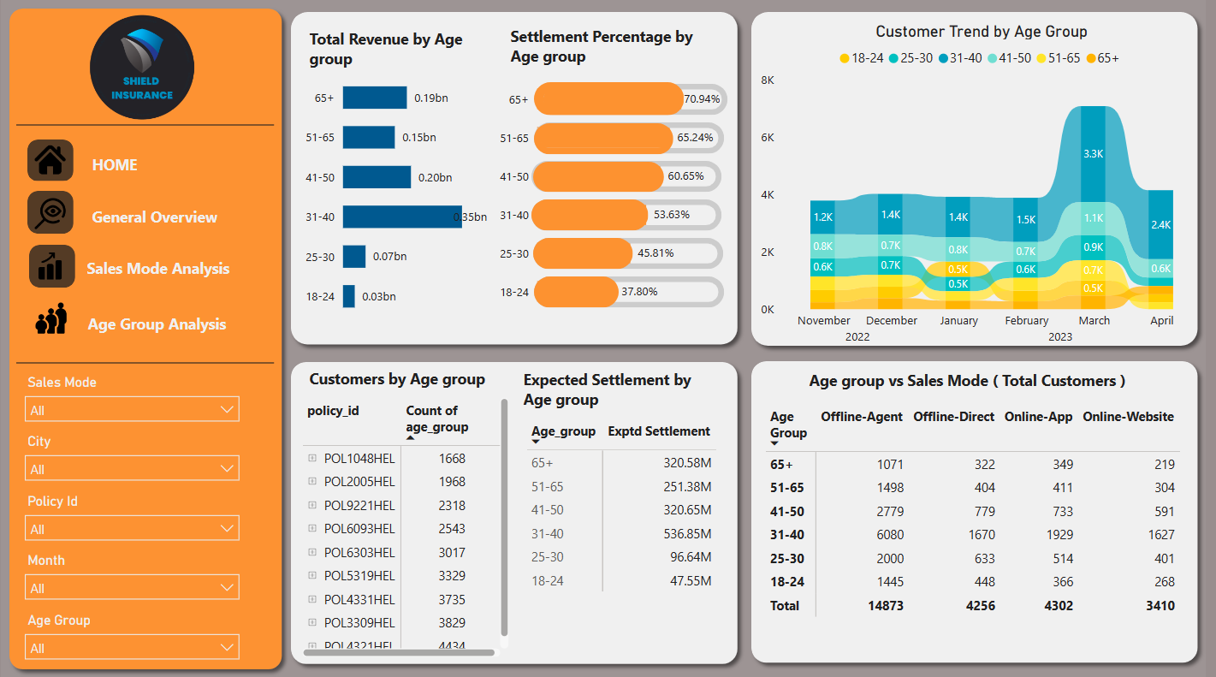
Age Group Analysis
Insights
The policy ID "POL4321HEL" has 4,434 customers. A big number of customers have picked this specific policy because its premium is only 5000 INR.
Across all plans, the 31-40 age group was the most regular customer base and highest revenue base.
The Expected Settlement % is roughly 74% for those aged 65 and older, and around 37% for those aged 18 to 24.

Slide 10

Future Outlook and Growth Strategies
Focus on Online Platform
Given the rising trend in online business since February 2023, continue to invest and expand the online presence.
Targeted Marketing
Leverage insights on the 31-40 age group's contribution to revenue and customer base.
Develop targeted marketing campaigns tailored to this age group to maximize acquisition and retention.
Enhance Offline Agent Performance
Despite the online growth, continue to invest in offline agents who are still significant contributors. Provide training and tools to optimize their sales performance.
Data Driven Decision Making
Invest in data analytics to better understand customer behaviour and preferences.
Use predictive analytics to anticipate customer needs and tailor offerings accordingly.
Product Innovation
Continuously innovate insurance products to meet evolving customer demands.
Consider customizable plans or bundled offerings that cater to specific customer segments.

Slide 11





Thank You!

